Slide 1

Predictive Modeling of Customer Bookings with Random Forest

Slide 2
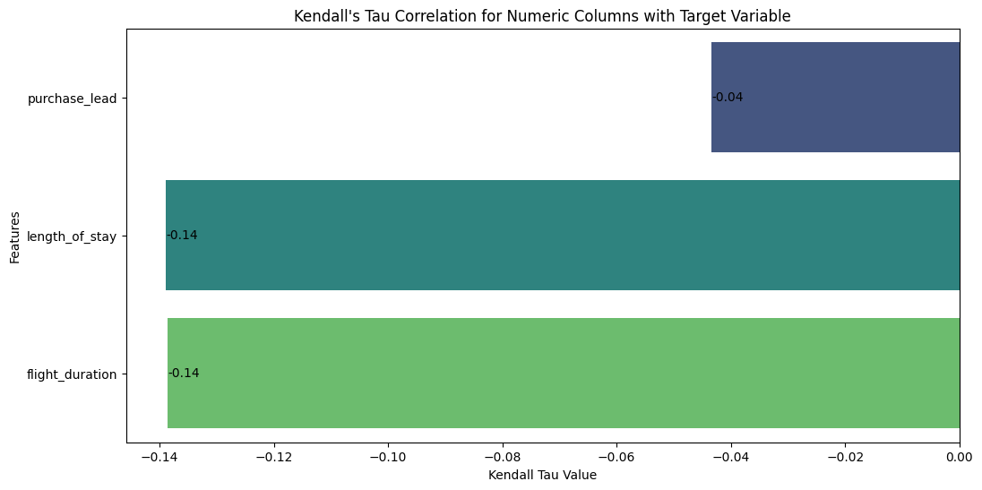
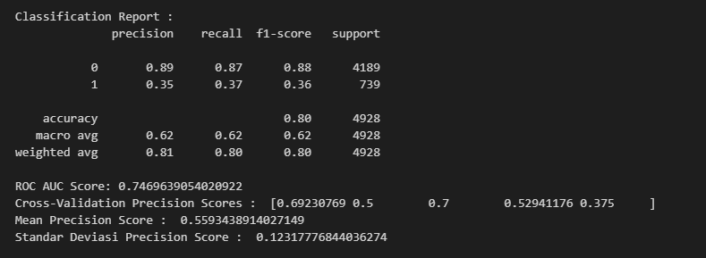
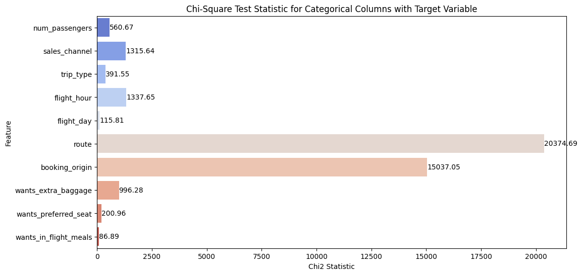
Factors That Influence Buying Behaviour with Statistical Method
Overall, although some numerical features have a negative Kendall's Tau (e.g., purchase_lead, length_of_stay, flight_duration), this does not mean that these features are not useful in the model. Negative correlation can still provide valuable information about how changes in the feature may affect the target. Machine learning models are capable of capturing more complex relationships that may not be immediately apparent through simple correlation analysis. On the other, many categorical features have highly significant Chi-Square test results
Model Random Forest Result
Using precision metrics, we have predict the test set with Random forest classifier model and received :
We need to increase the (target value : 1) Precision score.

